Slide 1
CS6907-13: Big Data and Analytics
Fall 2015
Stephen H. Kaisler, D.Sc.
Lecture 4 - Descriptive Analytics
Notes:
Project 2: march 21
Project 3: may 7th
Term paper – march 28th
Final exam- may 9th

Slide 2
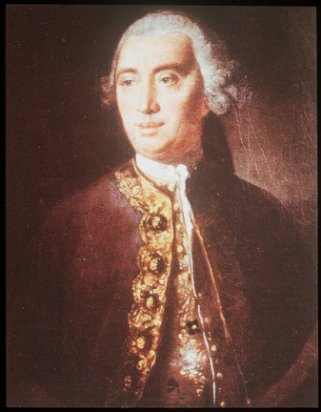
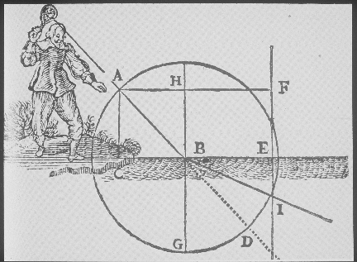
Descriptive Analytics
We are focused on causation: what events or factors caused (e.g., explain) some other event or situation.
Physicists discovered many useful laws:
  Snell’s Law
  Hooke’s Law
  Olm’s Law
  Joule’s Law
All used equations to describe how the world actually works
David Hume
CSCi 6907-12 Big Data and Analytics
4-<number>

Slide 3
Why Do We Model?
To overcome linear thinking: We cannot understand how the various parts of the system interact and add up to the whole
To discover the space of behaviors and cascading effects that real social systems can realize
To foresee novel events that our mental models cannot even imagine
To conduct virtual experiments on simulated social worlds on many scales
In summary, we model for three key reasons:
To gain insights into key variables and their causes and effects
To construct reasonable arguments as to why events can or cannot occur based on the model
To make qualitative or quantitative predictions about the future
CSCi 6907-12 Big Data and Analytics
4-<number>

Slide 4
Cause and Effect
According to Hume, causation is a learnable habit of the mind:
  When we see that two things go together, we learn that one “causes” the other (but,… caution about spurious correlations)
  When the flame burns us, we learn to keep away from it
In our everyday lives, we generally assume that people express rational behavior.
  Certainly, driving one’s car to work in Washington, D.C. is an example.
  People react to changes in the world in a way that is in their best interests, privately
  People generally learn cause and effect, and seek to optimize (Simon: “satisfice”) them for their own benefit
Simon’s principle: Social complexity is the result of (is caused by) the behavior of simple actors as they adapt to their complex environments
CSCi 6907-12 Big Data and Analytics
4-<number>

Slide 5
Causality
Equations Aren't Enough!
  Some social scientists just throw all their data into one massive regression equation, hoping that it will somehow control for all the variables.
Need to understand causality in order to understand how the world works
  Or, if we want to change the world
Experiments are the only guaranteed way to prove a causal model.
BUT: experiments cannot be done on many (most?) important social science problems
SO: we approximate them as best we can with correlational data, AND simulations
Computational simulations are powerful experimental tools for social scientists, just as they are for physical scientists (e.g., astronomy)
Judea Pearl, The Art and Science of Cause and Effect
CSCi 6907-12 Big Data and Analytics
4-<number>

Slide 6
Descriptive Analytics
Descriptive analytics answers the question:
"What happened in a given situation?“
The situation may be business, science, medical conditions, etc.
It looks at data and information to describe the current situation in a way that trends, patterns and exceptions become apparent.
"Remember, most raw data, especially big data, are not suitable for human consumption, but the information we derived from the data is.” – Michael Wu, Lithium Technologies
Wu estimated that more than 80% of business analytics -- most notably social analytics -- are descriptive.
"For example, number of posts, mentions, fans, followers, page views, kudos, +1s, check-ins, pins, etc. There are literally thousands of these metrics -- it's pointless to list them -- but they are all just simple event counters.” – Michael Wu
CSCi 6907-12 Big Data and Analytics
4-<number>

Slide 7
Cluster Analysis - I
Cluster Analysis is the process of finding groups of objects such that the objects in a group will be similar (or related) to one another and different from (or unrelated to) the objects in other groups.
Inter-cluster distances are maximized
Intra-cluster distances are minimized
CSCI 6907-12 Big Data and Analytics
4-<number>

Slide 8
Cluster Analysis - II
Why?
  Reduce the size of large data sets to something more manageable
  Select only those entities/objects that are similar to one another for further analysis
Partitional Clustering
  A division data objects into non-overlapping subsets (clusters) such that each data object is in exactly one subset
Hierarchical clustering
  A set of nested clusters organized as a hierarchical tree
CSCI 6907-12 Big Data and Analytics
4-<number>

Slide 9
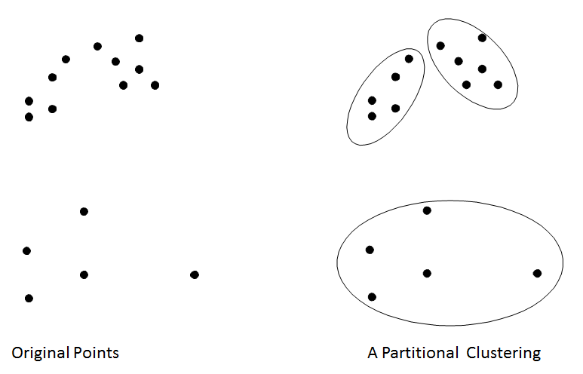
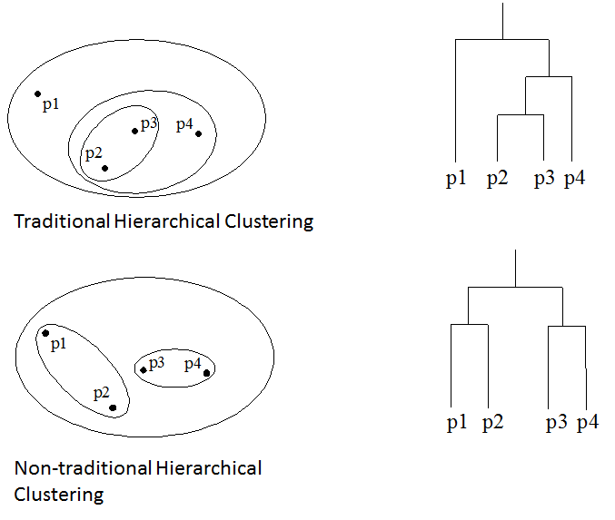
Cluster Analysis - IV
Partitional Clustering
Hierarchical Clustering
Many other types of clusters and methods for clustering.
CSCI 6907-12 Big Data and Analytics
4-<number>
Notes:
For mushroom we will be ignoring edible and poisonous and classifyig remaining 30%

Slide 10
What is not Cluster Analysis?
Supervised classification
  Have class label information
Simple segmentation
  Dividing students into different registration groups alphabetically, by last name
Results of a query
  Groupings are a result of an external specification
Graph partitioning
  Some mutual relevance and synergy, but areas are not identical
CSCI 6907-12 Big Data and Analytics
4-<number>

Slide 11

K-Means Clustering - I
Partitional clustering approach
Each cluster is associated with a centroid (center point)
Each point is assigned to the cluster with the closest centroid
Number of clusters, K, must be specified
The basic algorithm is very simple:
CSCI 6907-12 Big Data and Analytics
4-<number>
Notes:
One rule is sqrt of N as number of clusters
For distance in assignment we will have to convert letters to numbers
Value of centroid may not correspond to value in actual data set

Slide 12
K-Means Clustering - II
Initial centroids are often chosen randomly.
  Clusters produced vary from one run to another.
The centroid is (typically) the mean of the points in the cluster.
‘Closeness’ is measured by Euclidean distance, cosine similarity, correlation, etc.
K-means will converge for common similarity measures mentioned above.
Most of the convergence happens in the first few iterations.
  Often the stopping condition is changed to ‘Until relatively few points change clusters’
Complexity is O( n * K * I * d )
  n = number of points, K = number of clusters,
  I = number of iterations, d = number of attributes
CSCI 6907-12 Big Data and Analytics
4-<number>
Notes:
Big O (complexity is big O) -> gives you a number and can compare this to other algorithms based on the value

Slide 13
K-means Clustering - III
Formula:
  ss(k) = Σ_{i=1}^{n} Σ_{j=0}^{p} (x_{ij} –x_{kj})²
R Call: kmeans(matrix, centers)
  Matrix: a numeric dataset as a matrix or data frame
  Centers: # clusters to return
  Because it uses random seeding, you will get a different solution each call
  To ensure reproducibility, use set.seed(…) to set the random number generator seed
Clustering used to identify subgroups within a data set
CSCi 6907-12 Big Data and Analytics
4-<number>

Slide 14
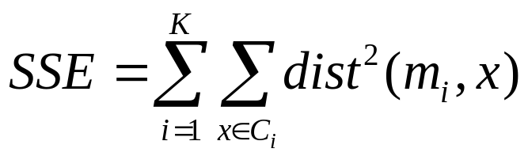
Evaluating K-means Clusters
Most common measure is Sum of Squared Error (SSE)
  For each point, the error is the distance to the nearest cluster
  To get SSE, we square these errors and sum them.
  x is a data point in cluster C_{i} and m_{i} is the representative point for cluster C_{i}
    can show that m_{i} corresponds to the center (mean) of the cluster
  Given two clusters, we can choose the one with the smallest error
  One easy way to reduce SSE is to increase K, the number of clusters
    A good clustering with smaller K can have a lower SSE than a poor clustering with higher K
CSCI 6907-12 Big Data and Analytics
4-<number>

Slide 15
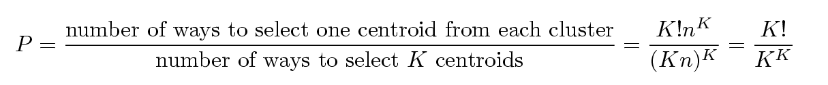
Selecting Initial Points
If there are K ‘real’ clusters then the chance of selecting one centroid from each cluster is small.
  Chance is relatively small when K is large
  If clusters are the same size, n, then
  For example, if K = 10, then probability = 10!/10¹⁰ = 0.00036
  Sometimes the initial centroids will readjust themselves in ‘right’ way, and sometimes they don’t
CSCI 6907-12 Big Data and Analytics
4-<number>

Slide 16
Some Issues
Handling empty clusters:
  Of the k specified, some may be empty
  Experiment w/ values of k
Update centroids incrementally:
  Update centroid after each assignment rather than at the end of all assignments.
Clusters may have different sizes, densities and shapes:
  Possibly change distance function; there are many
  Different shapes may mean entities could belong to two or more clusters depending on their closeness.
Dealing w/ outliers:
  Some entities will not fit into any cluster
CSCI 6907-12 Big Data and Analytics
4-<number>

Slide 17
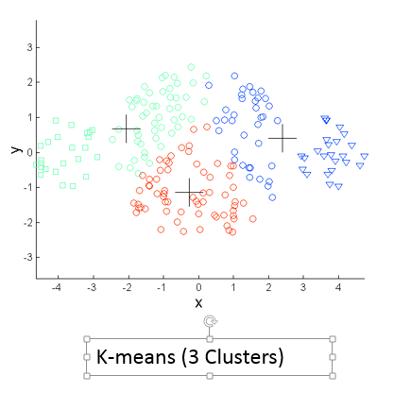
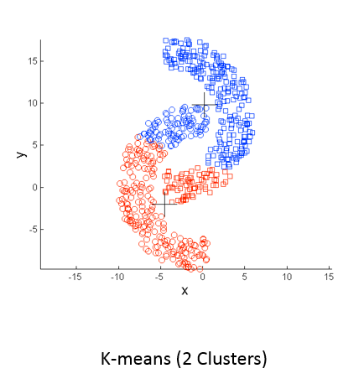
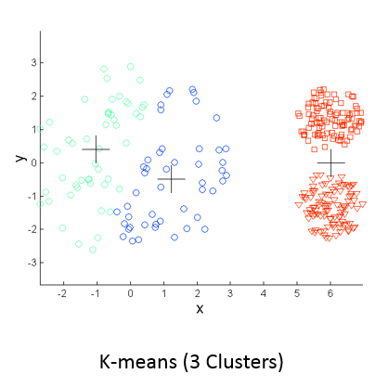
Examples of Issues
Different sizes
Different Shapes
Different Densities
CSCI 6907-12 Big Data and Analytics
4-<number>

Slide 18
Hierarchical Clustering
Do not have to assume any particular number of clusters
  Any desired number of clusters can be obtained by ‘cutting’ the dendogram at the proper level
They may correspond to meaningful taxonomies
  Example in biological sciences (e.g., animal kingdom, phylogeny reconstruction, …)
Two main types of hierarchical clustering:
  Agglomerative:
    Start with the points as individual clusters
    At each step, merge the closest pair of clusters until only one cluster (or k clusters) left
  Divisive:
    Start with one, all-inclusive cluster
    At each step, split a cluster until each cluster contains a point (or there are k clusters)
CSCI 6907-12 Big Data and Analytics
4-<number>

Slide 19
Agglomerative Clustering
More popular hierarchical clustering technique
Basic algorithm is straightforward
  Compute the proximity matrix
  Let each data point be a cluster
  Repeat
  Merge the two closest clusters
  Update the proximity matrix
  Until only a single cluster remains
Key operation is the computation of the proximity of two clusters
  Different approaches to defining the distance between clusters distinguish the different algorithms
CSCI 6907-12 Big Data and Analytics
4-<number>

Slide 20
Hierarchical Clustering: Issues
Once a decision is made to combine two clusters, it cannot be undone
No objective function is directly minimized
Different schemes have problems with one or more of the following:
  Sensitivity to noise and outliers
  Difficulty handling different sized clusters and convex shapes
  Breaking large clusters
CSCI 6907-12 Big Data and Analytics
4-<number>

Slide 21
Clustering Summary
For cluster analysis, how to evaluate the “goodness” of the resulting clusters?
But “clusters are in the eye of the beholder”!
Then why do we want to evaluate them?
  To avoid finding patterns in noise
  To compare clustering algorithms
  To compare two sets of clusters or to compare two clusters
Determining the clustering tendency of a set of data, i.e., distinguishing whether non-random structure actually exists in the data.
Comparing the results of a cluster analysis to externally known results, e.g., to externally given class labels.
Evaluating how well the results of a cluster analysis fit the data without reference to external information.
Determining the ‘correct’ number of clusters.
CSCI 6907-12 Big Data and Analytics
4-<number>

Slide 22
Cluster Analysis Process - I
Choose appropriate attributes;
  Look for attributes that differentiate items in the set
  A sophisticated cluster analysis cannot compensate for a poor choice of variables
Scale the data
  If the variables vary in range, the variables with the largest values will predominate and skew results
  Normalize (standardize) variables to a range [0…1] with standard deviation of 1.
  Other techniques may apply
Screen for outliers:
  Many clustering techniques are sensitive to outliers
  Use the outliers package to assist you (or, mvouttlier for multivariate
  outliers
  Use clustering technique robust in presence of outliers
CSCi 6907-12 Big Data and Analytics
4-<number>
Notes:
Only scale within the attribute, not across

Slide 23
Cluster Analysis Process – II
Calculate distances:
  Select a distance measure: Euclidean, Manhattan, Minkowski, and so on.
Select a clustering algorithm:
  Hierarchical clustering is good for a few hundred observations
  Partitioning methods handle much larger data sets
Apply the clustering algorithm varying the parameters:
Determine # clusters present:
  Tough problem, no generic solutions
  Domain knowledge helpful
  Use the NbClust package which has 30 indices
Obtain a final clustering solution:
  Perform a final clustering with the best set of parameters
  There is NO optimal solution, usually
CSCi 6907-12 Big Data and Analytics
4-<number>

Slide 24
Cluster Analysis Process – III
Visualize the results:
  Hierarchical clustering usually displayed as a dendrogram
  Partitioning clustering usually displayed as bivariate cluster plot
  You may have to select pairs of variables to plot (latter case)
Interpret the clusters:
  Examining the clusters, find what is common and what is not
  Requires domain knowledge
  Obtain summary statistics
  If categorical variables, look at modes and/or category distributions
Validate the results:
  Are these groupings represented in the real world in some way?
  If a different clustering method was used, would the same clusters be obtained?
  Try the fpc, clv, and clValid packages
CSCi 6907-12 Big Data and Analytics
4-<number>

Slide 25
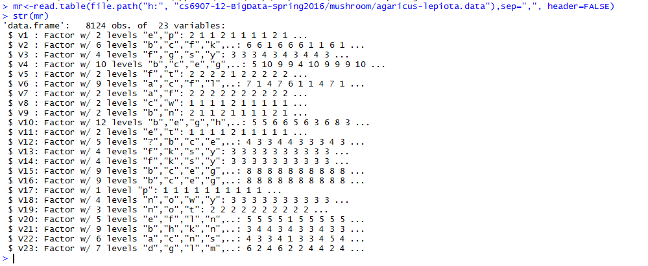
R: Cluster Analysis
Use the Mushroom Data
Mushroom data is available on Blackboard in
CSCI 6907-12 Big Data and Analytics
4-<number>

Slide 26
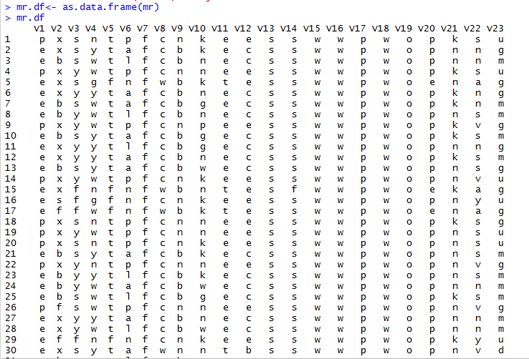
R: Cluster Analysis
Convert to a data frame (most of listing omitted)
CSCI 6907-12 Big Data and Analytics
4-<number>

Slide 27
R: Cluster Analysis
Attribute Information:
1. cap-shape: bell=b,conical=c,convex=x,flat=f, knobbed=k,sunken=s
2. cap-surface: fibrous=f,grooves=g,scaly=y,smooth=s
3. cap-color: brown=n,buff=b,cinnamon=c,gray=g,green=r, pink=p,purple=u,red=e,white=w,yellow=y
4. bruises?: bruises=t,no=f
5. odor: almond=a,anise=l,creosote=c,fishy=y,foul=f, musty=m,none=n,pungent=p,spicy=s
6. gill-attachment: attached=a,descending=d,free=f,notched=n
7. gill-spacing: close=c,crowded=w,distant=d
8. gill-size: broad=b,narrow=n
9. gill-color: black=k,brown=n,buff=b,chocolate=h,gray=g, green=r,orange=o,pink=p,purple=u,red=e, white=w,yellow=y
10. stalk-shape: enlarging=e,tapering=t
11. stalk-root: bulbous=b,club=c,cup=u,equal=e, rhizomorphs=z,rooted=r,missing=?
CSCI 6907-12 Big Data and Analytics
4-<number>

Slide 28
R: Cluster Analysis
12. stalk-surface-above-ring: fibrous=f,scaly=y,silky=k,smooth=s
13. stalk-surface-below-ring: fibrous=f,scaly=y,silky=k,smooth=s
14. stalk-color-above-ring: brown=n,buff=b,cinnamon=c,gray=g,orange=o, pink=p,red=e,white=w,yellow=y
15. stalk-color-below-ring: brown=n,buff=b,cinnamon=c,gray=g,orange=o, pink=p,red=e,white=w,yellow=y
16. veil-type: partial=p,universal=u
17. veil-color: brown=n,orange=o,white=w,yellow=y
18. ring-number: none=n,one=o,two=t
19. ring-type: cobwebby=c,evanescent=e,flaring=f,large=l, none=n,pendant=p,sheathing=s,zone=z
20. spore-print-color: black=k,brown=n,buff=b,chocolate=h,green=r, orange=o,purple=u,white=w,yellow=y
21. population: abundant=a,clustered=c,numerous=n, scattered=s,several=v,solitary=y
22. habitat: grasses=g,leaves=l,meadows=m,paths=p, urban=u,waste=w,woods=d
CSCI 6907-12 Big Data and Analytics
4-<number>

Slide 29
R: Cluster Analysis
Create Names vector with name of Mushroom data fields:
names(mr) <- c("class","cshape","csurface","ccolor","bruises","odor","gattach","gspace“
"gsize","gcolor","sshape","sroot","ssabove","ssbelow","scabove","scbelow","vtype","vcolor“
"rnumber","rtype","spcolor","popnum","habitat")
names(mr)
[1] "class" "cshape" "csurface" "ccolor" "bruises" "odor" "gattach" "gspace" "gsize“
"gcolor" "sshape" "sroot“
[13] "ssabove" "ssbelow" "scabove" "scbelow" "vtype" "vcolor" "rnumber" "rtype" "spcolor“
"popnum" "habitat"
Mushroom data consists of three classes: e=edible, p=poisonous,and mushrooms that can’t be decided
  The undecideds are lumped together with the poisonous mushrooms (erring on the side of caution)
Plotting the data, you get a very hard to read set of plots.
The file MRDataPlot.jpg shows an expanded view.
CSCI 6907-12 Big Data and Analytics
4-<number>

Slide 30
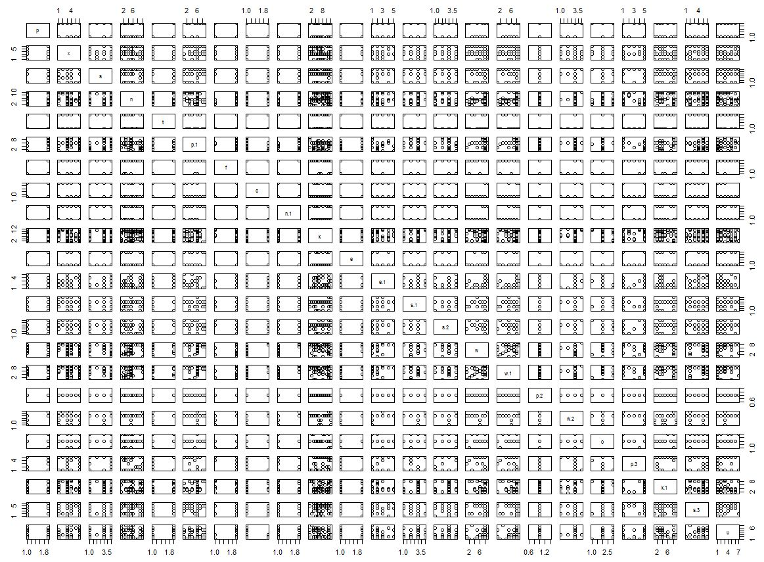
R: Cluster Analysis
CSCI 6907-12 Big Data and Analytics
4-<number>

Slide 31
R: Cluster Analysis
What a mess! Can barely read anything
So, plot individual pairs of fields for better visualization
pairs(class ~ cshape + csurface + ccolor, data=mr)
  Call: pairs(<formula>, data=<dataset>)
  Formula: variable ~ <in terms of other variables>
  See next slide
We know there are two classes: e and p
  Actually, three classes, but third is not labeled individually
Look at “class” versus” “cshape”
  Clear delineation of two classes as we expect
  For cshape, we see linearity - either vertically or horizontally, which tells us the values of shape are closely correlated with the surface. We didn’t know this before, but might have guessed it.
But, “cshape” versus “ccolor”
  Not clear as to relationship
CSCI 6907-12 Big Data and Analytics
4-<number>

Slide 32
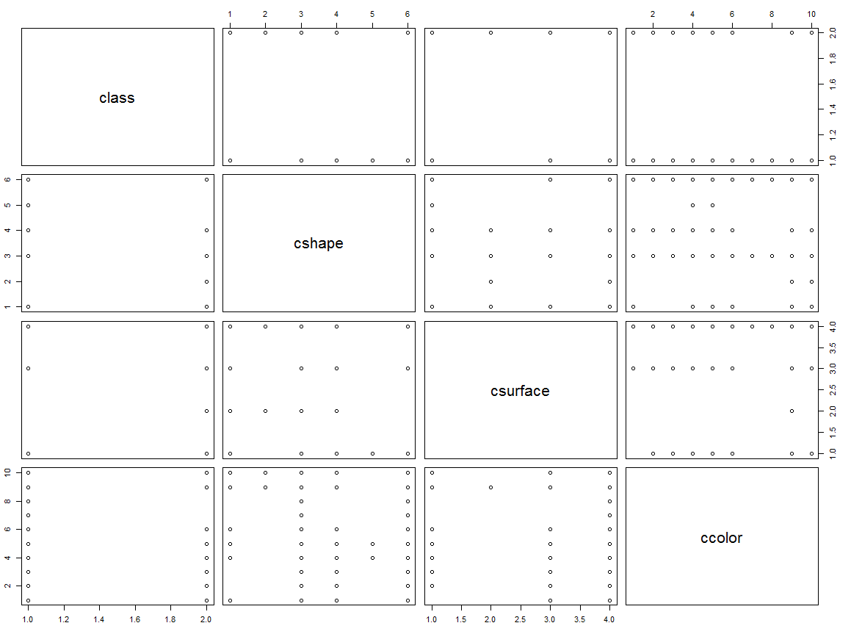
R: Cluster Analysis
CSCI 6907-12 Big Data and Analytics
4-<number>

Slide 33
R: Cluster Analysis
Plot(class ~ sroot, data=mr)
stalk-root: bulbous=b,club=c,cup=u,equal=e, rhizomorphs=z,rooted=r,missing=?
So, sroot having the attribute club, equal, or rhizomorphs characterize both edible and poisonous whereas bulbous only characterizes edible.
So, this could lead to a rule that says:
If the sroot is bulbous, it is edible. BUT, that is not the only rule!
THUS: You should consider doing pairwise comparisons and seeing what conclusions you can draw.
CSCI 6907-12 Big Data and Analytics
4-<number>

Slide 34
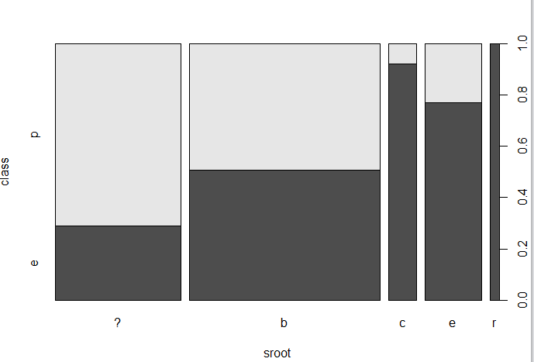
R: Cluster Analysis
CSCI 6907-12 Big Data and Analytics
4-<number>

Slide 35
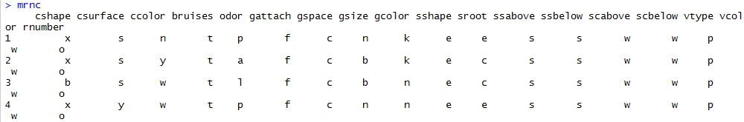
R: Cluster Analysis
Create a data frame with no class information
mrnc <- mr[-1]
Rest of each row and rows beyond 4 omitted
CSCI 6907-12 Big Data and Analytics
4-<number>

Slide 36

CSCI 6907-12 Big Data and Analytics
4-<number>

Slide 37
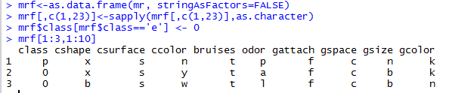
R: Cluster Analysis
You must convert character data to numerical data to work with clustering function
So, we see that ‘e’ has been converted to 0
CSCI 6907-12 Big Data and Analytics
4-<number>

Slide 38
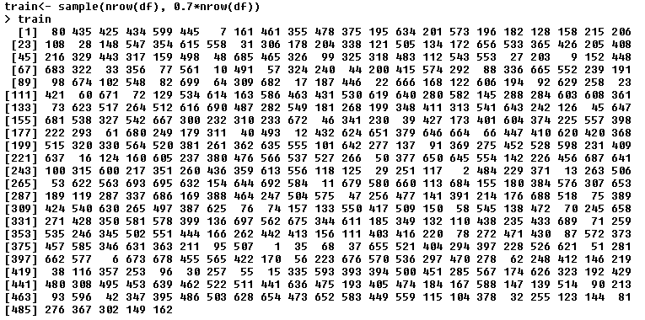
More Analysis - III
>names(breast) <- c("ID", "clumpThickness", "sizeUniformity", "shapeUniformity", "marginalAdhesion",
"SingleEpithelialCellSize", "bareNuclei", "blandChromatin", "normalNucleoli", "mitosis", "class")
names(breast)
[1] "ID" "clumpThickness" "sizeUniformity"
[4] "shapeUniformity" "marginalAdhesion" "SingleEpithelialCellSize“
[7] "bareNuclei" "blandChromatin" "normalNucleoli“
[10] "mitosis" "class“
df <- breast[-1] // drops the ID
df$class <- Factor(df$class, levels=c(2,4), labels=c(“benign”, “malignant”))
set.seed(1234) // Set a constant random seed
- Create a training set of 70% of the samples
CSCi 6907-12 Big Data and Analytics
4-<number>

Slide 39
More Analysis - IV
- Extract the training records from the main dataset
> df.train <- df[train,]
- and, the validation records
> df.validate <- df[-train,]
- print these out to see contents, but I won’t do it here
table(df.train$class)
2 4 // class of tumor
329 160 // # of each type in training set
table(df.validate$class)
2 4 // class of tumor
129 81 // # of each type in validation set
CSCi 6907-12 Big Data and Analytics
4-<number>

Slide 40
More Analysis - V
Training sample will be used to create classification schemes
Validation sample will be used to evaluate the effectiveness of these schemes
For glm(), the decision variable must have values
0 <= y <= 1
So, we fix our data as follows:
df.train$class[df.train$class == 4] <- 1
df.train$class[df.train$class == 2] <- 0
Check the data files and you will see that the “2”s and “4”s have been replaced by “0”s and “1”s
CSCi 6907-12 Big Data and Analytics
4-<number>

Slide 41
Data Reduction Techniques
Principal Components Analysis is a data reduction technique that reduces the number of variables in a data set for easier explanation
  use principal() in the psych package
  The principal components are linear combinations of the observed variables
  The principal components are orthogonal to each other (think vector spaces)
Exploratory Factor Analysis seeks to uncover the latent structure in a give set of variables
  Use factanal()
Both techniques obtain their solutions by seeking correlations among the observed variables.
CSCi 6907-12 Big Data and Analytics
4-<number>

Slide 42
Principal Components Analysis
Mathematical technique used to reduce a multidimensional data set to 2 or 3 dimensions to enable detection of broad trends and facilitate visualization
Why reduce dimensionality?
  Reduce time complexity: less computation
  Reduce space complexity: less parameters
  Don’t have to observe eliminated features
  Simpler models more robust on smaller data sets
  Simple explanations often good enough
  Can plot data in 2- or 3-D visualizations; more understandable
CSCi 6907-12 Big Data and Analytics
4-<number>

Slide 43
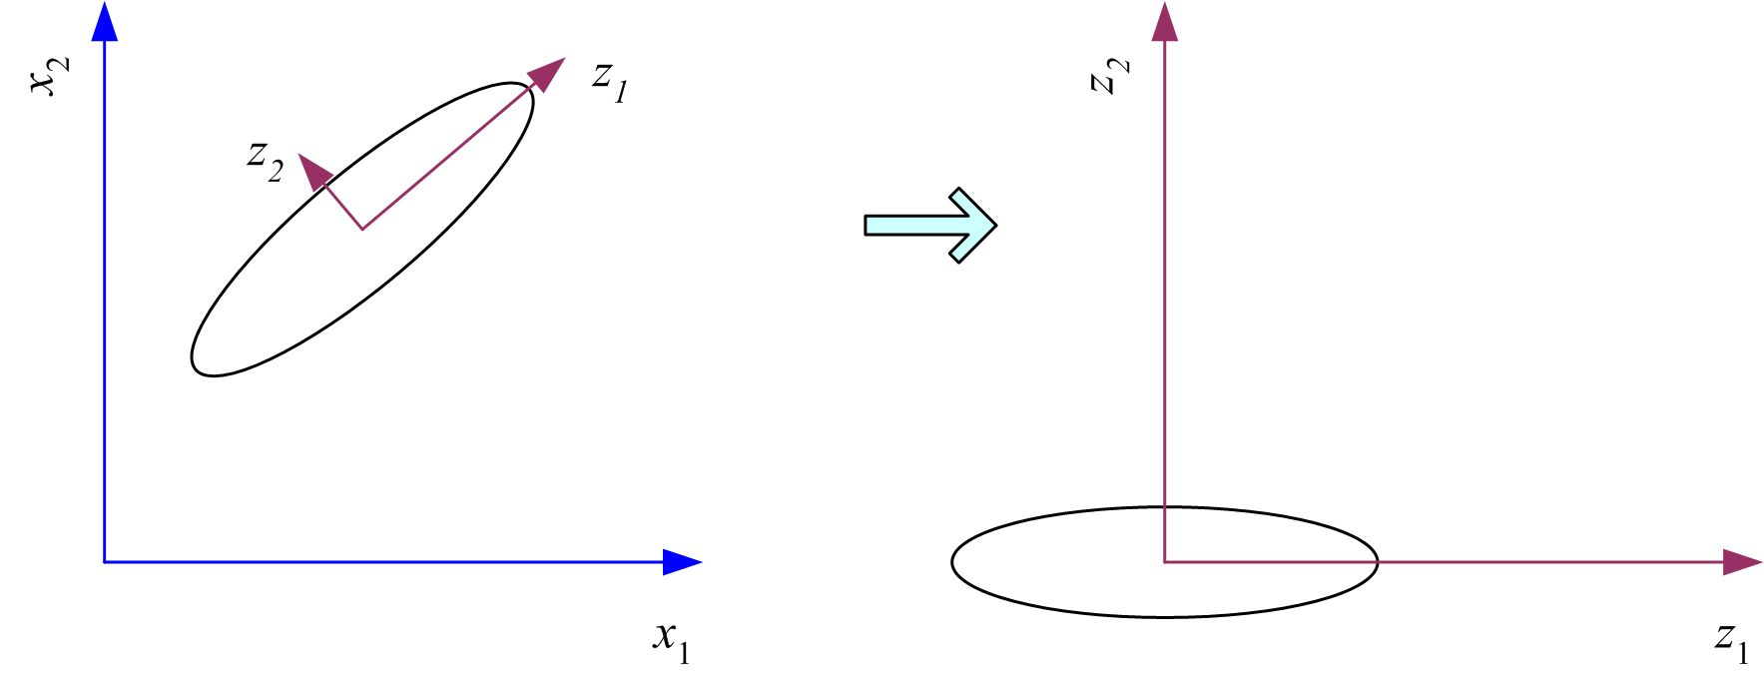
Principal Component Analysis
A technique for mapping a multidimensional space to 2 or 3 dimensions
Given vector x, its projection on some axis w is z = W^{T}(x – m)
Maximize var(Z) by choosing eigenvectors as new dimension’s bases
Var(z) = w^{T} E[(x – μ)(x –μ)^{T}]w = w^{T} ∑ w
Var(x)= E[(x – μ)(x –μ)^{T}] = ∑
Center data at origin and rotate axes - improve understanding
CSCi 6907-12 Big Data and Analytics
4-<number>

Slide 44
PCA: A Factor Analysis Model
Factor Analysis: a class of procedures primarily used for data reduction and summarization.
  Used to identify underlying dimensions, or factors, that explain the correlations among a set of variables.
Each variable is expressed as a linear combination of underlying factors.
X_{i} = A_{i 1}F₁ + A_{i 2}F₂ + A_{i 3}F₃ + . . . + A_{im}F_{m} + V_{i}U_{i}
where
X_{i} = i th standardized variable
A_{ij} = standardized multiple regression coefficient of variable i on common factor j
F_{i} = common factor
V_{i} = standardized regression coefficient of variable i on unique factor i
U_{i} = the unique factor for variable i
m = number of common factors
CSCi 6907-12 Big Data and Analytics
4-<number>

Slide 45
PCA: A Factor Analysis Model
Unique factors are uncorrelated with each other and with the common factors.
Common factors are expressed as linear combinations of the observed variables X_{i}
F_{i} = W_{i1}X₁ + W_{i2}X₂ + W_{i3}X₃ + . . . + W_{ik}X_{k}
where
F_{i} = estimate of i th factor
W_{i} = weight or factor score coefficient
k = number of variables
CSCi 6907-12 Big Data and Analytics
4-<number>

Slide 46
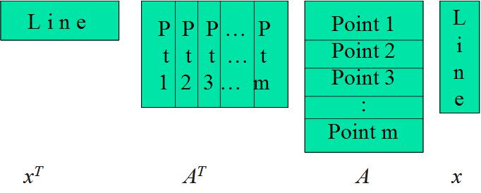
PCA - Algebraic Formulation
Express in matrix form:
Sum of squares is:
max( x^{T}A^{T} Ax), subject to x^{T}x = 1
x^{T}A^{T}Ax = e = e x^{T}x = x^{T} (ex)
<=> x^{T} (A^{T}Ax – ex) = 0
x is an eigenvector and e an
eigenvalue if
ex=(A^{T}A)x
x
CSCi 6907-12 Big Data and Analytics
4-<number>

Slide 47
PCA - Algebraic Formulation
How many eigenvectors are there?
Except in degenerate cases when eigenvalues repeat, there are n eigenvectors
  x₁…x_{n} are the eigenvectors
  e₁…e_{n} are the eigenvalues
All eigenvectors are mutually orthogonal and therefore form a new basis
Eigenvectors corresponding to the same eigenvalue have the property that any linear combination is also an eigenvector with the same eigenvalue; one can then find as many orthogonal eigenvectors as the number of repeats of the eigenvalue.
Since the eigenvectors form a basis:
  (A^{T} A) y =(A^{T}A) (a₁x₁+a₂x₂……..+a_{n}x_{n}) =a₁e₁x₁+….+a_{n}e_{n}x_{n}
  (A^{T} A)(A^{T} A) y=a₁e₁e₁x₁+….+a_{n}e_{n}e_{n} x_{n}
CSCi 6907-12 Big Data and Analytics
4-<number>

Slide 48
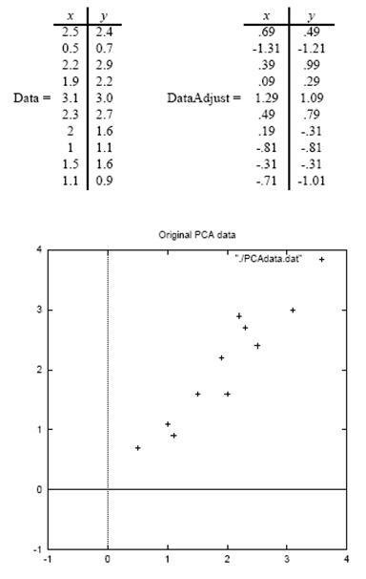

PCA – Simple Procedure
Step 1: Subtract the mean from each of the data dimensions to produce a data set whose mean is zero.
Step 2 - Calculate the covariance matrix
Non-diagonal elements are positive, so both x and y increase together (see plot)
Ref: Lindsay I. Smith, A Tutorial on Principal Components Analysis
CSCi 6907-12 Big Data and Analytics
4-<number>

Slide 49
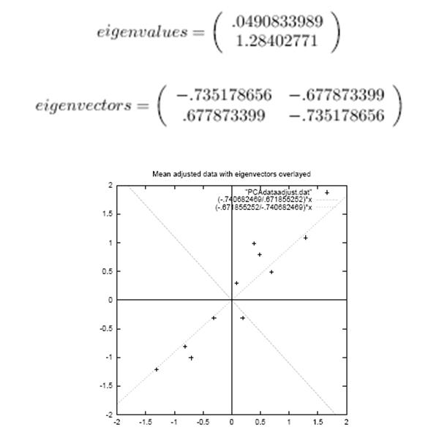
PCA – Simple Procedure
Step 3 - Calculate the eigenvalues and eigenvectors of the covariance matrix
  Since the covariance matrix is square, we can calculate the eigenvalues and eigenvectors
  The eigenvector with the highest eigenvalue is the principle component of the data set
  Eigenvector (1) shows linear relationship among data points
  Eigenvector (2) shows that data points all follow a linear path, but are removed by some distance
Now, characterize the data using the eigenvectors to make it more understandable
(1)
(2)
CSCi 6907-12 Big Data and Analytics
4-<number>
Notes:
Eigenvector – positive then x and y increase together.

Slide 50
PCA – Simple Procedure
Step 4 – Derive the new data
FinalData = RowFeatureVector x RowZeroMeanData
RowFeatureVector is the matrix with the eigenvectors in the columns transposed so that the eigenvectors are now in the rows, with the most significant eigenvector at the top
RowZeroMeanData is the mean-adjusted data transposed, i.e., the data items are in each column, with each row holding a separate dimension.
FinalData is the final data set, with data items in columns, and dimensions along rows.
What will this give us? It will give us the original data solely in terms of the vectors we chose.
To get original data back:
RowOriginalData = (RowFeatureVector^{T} x FinalData) + OriginalMean
CSCi 6907-12 Big Data and Analytics
4-<number>

Slide 51
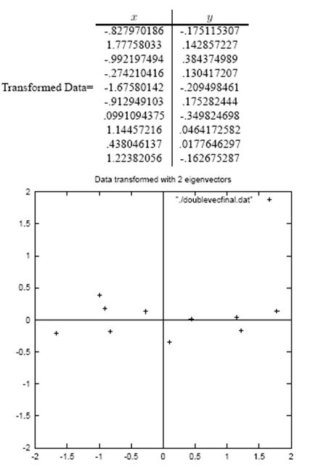
PCA – Simple Procedure
Step 5 – Reduce dimensionality and form feature vector
  Once eigenvectors are found from the covariance matrix, the next step is to order them by eigenvalue, highest to lowest. This gives you the components in order of significance
  With n eigenvalues, choose only the first p to represent you data
  So, the feature vector = (eig₁ eig₂ … eig_{p})
CSCi 6907-12 Big Data and Analytics
4-<number>

Slide 52
Principal Component Analysis - I
Need to decide how many components to extract:
  Based in prior experience and theory
  Selecting # components needed to account for some threshold of variance
  Selecting # of components by inspecting eigenvalues of the k x k correlation matrix.
Eliminate column 6 – bareNuclei because it has some NAs in it
Principal results:
  PC1 contains the component loadings, which are the correlations of the observed variables with the principal components
  Same for PC2 and PC3 since we extracted three factors
  SS contains the eigenvalues associated with the components
  ProportionVar is the amount of variance accounted for by each component.
CSCi 6907-12 Big Data and Analytics
4-<number>

Slide 53
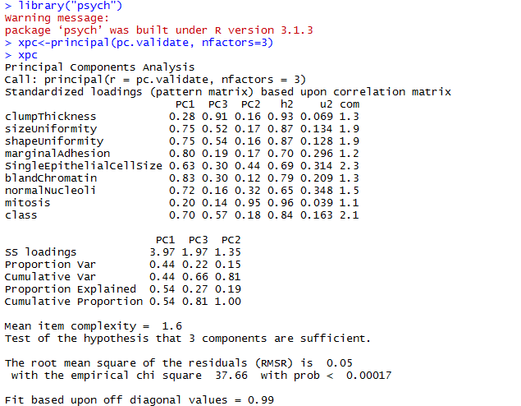
Principal Component Analysis - II
CSCi 6907-12 Big Data and Analytics
4-<number>
Notes:
Ss loading-telling you contribution of that component in the vector (higher better, explained in package description)

Slide 54
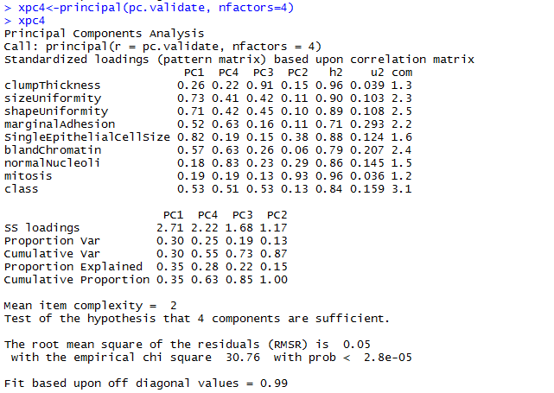
Principal Component Analysis - III
Now, try it again with extracting four factors
CSCi 6907-12 Big Data and Analytics
4-<number>

Slide 55
Variance & Covariance
Variance measures the spread of data in a data set
  For 1-D data, computation is straightforward
Consider 2-D data: how do each of the dimensions vary with each other
  Data points with two attributes; think of them as x and y, which you can plot on a 2-D graph
  Lots of points makes it difficult to visualize patterns in the data
  Example: # hours studied versus grades obtained
  Yields a number, but what does it mean?
    = 0, the two dimensions are independent of each other
    > 0, two dimensions vary together
    < 0, two dimensions vary in opposition
  With 2-D can usually visualize this result, but 3-D and beyond cannot visualize so need some way to characterize how the different dimension relate to each
Cov(x,y) = Σ (x_{i} –x) (y_{i} – y)/(n-1) for i =1, n
CSCi 6907-12 Big Data and Analytics
4-<number>

Slide 56
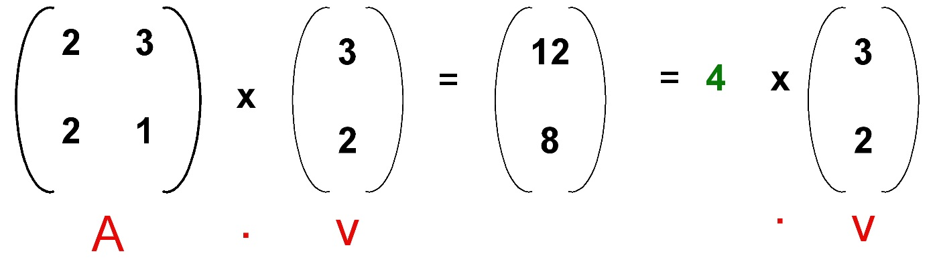

Eigenvalues & Eigenvectors
An eigenvalue problem may be written as a matrix equation:
A . v = λ . v
Any solution for λ is the eigenvalue and v is the eigenvector.
CSCi 6907-12 Big Data and Analytics

Slide 57
Calculating Eigenvalues - I
Suppose we are given: A . v = λ . v
A . v - λ . I . v = 0
(A - λ . I ). v = 0
Finding the roots of |A - λ . I| will give the eigenvalues
Let A = (0 1)
(-2 -3)
Then, (A-λ.I) = (0 1) (λ 0)
(-2 -3) - (0 λ) = 0, then (-λ 1) = λ² + 3λ + 2 = 0
(-2 -3-λ)
So, there are two eigenvalues: λ₁ = -1 and λ₂ = -2
For λ1, the eigenvector is (1 1) (v_{1:1})
(-2 -2) (v_{1:2}) = 0 or v_{1:1} = - v_{1:2}
So, any column vector with components of equal magnitude and opposite sign.
CSCi 6907-12 Big Data and Analytics
4-<number>

Slide 58
Calculating Eigenvalues - II
Therefore eigenvector v₁ is v₁ = k₁ ( +1)
( -1) where k₁ is some constant
And, eigenvector v₂ is v₂ = k₂ (+1)
(-2) where k₂ is some constant
And the eigenvalues are λ₁ = -1 and λ₂ = -2
Eigenvectors can only be found for square matrices; not every square matrix has eigenvectors.
Given an n x n matrix, we can find n eigenvectors
CSCi 6907-12 Big Data and Analytics
4-<number>

Slide 59
Scatterplots
Describe the relationship between two continuous variables (x versus y)
  Use plot(x,y) in R
  Use the mtcars data frame
    install.packages(mtcars)
    library(mtcars)
Uses circles to represent data points
Use abline() to add a linear line of best fits (red line)
Use lowess() to add a smoothed line (blue line)
Examples taken from R in Action by Robert Kabacoff, Manning Publications, Shelter Island, NY
CSCI 6907-13 Big Data & Analytics
CSCI 6907-13 Big Data & Analytics

Slide 60
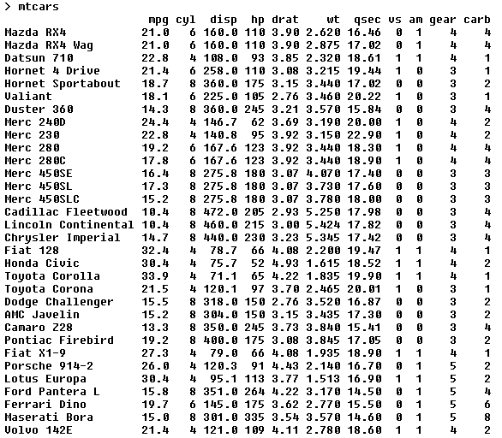
Scatterplot: mtcars data
CSCI 6907-13 Big Data & Analytics
CSCI 6907-13 Big Data & Analytics

Slide 61
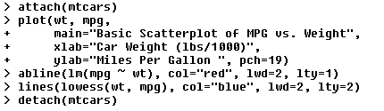
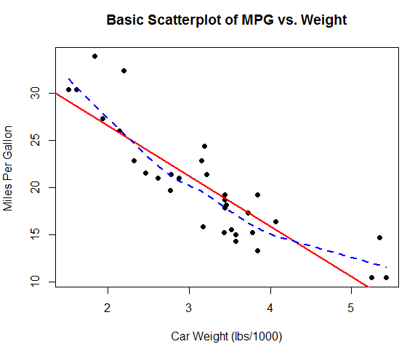
Scatterplot with Best Fit Lines
CSCI 6907-13 Big Data & Analytics
CSCI 6907-13 Big Data & Analytics

Slide 62
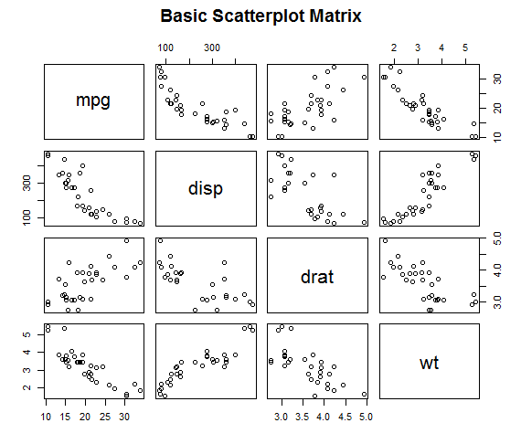
Basic Scatterplot
Specifies the
bivariate
relationship among all the variables.
Six plots below the diagonal are the same as those above.
Set upper.panel = NULL to just show the six below.
CSCI 6907-13 Big Data & Analytics
CSCI 6907-13 Big Data & Analytics

Slide 63

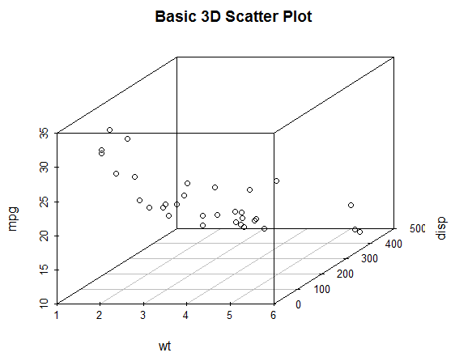
3D Scatterplots
Can visualize relationships among three variables
CSCI 6907-13 Big Data & Analytics
CSCI 6907-13 Big Data & Analytics

Slide 64
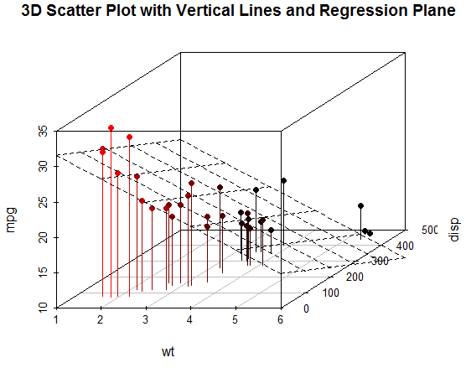
Scatterplot w/ Regression Pane
Visualize the prediction
of mpg based on auto weight and displacement.
The plane represents the predicted values.
Points above the plane are underpredicted.
And, those below are overpredicted.
CSCI 6907-13 Big Data & Analytics
CSCI 6907-13 Big Data & Analytics

Slide 65
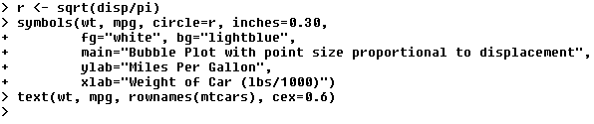
Bubble Plots
Plot two variables and use the size of the plotted point to represent the third variable.
  Use the symbols() function
  Can draw circles, stars, squares, thermometers, and box plots
  Text() adds names to the circles
With lots of data, overlap occurs and makes it hard to visualize
CSCI 6907-13 Big Data & Analytics
CSCI 6907-13 Big Data & Analytics

Slide 66
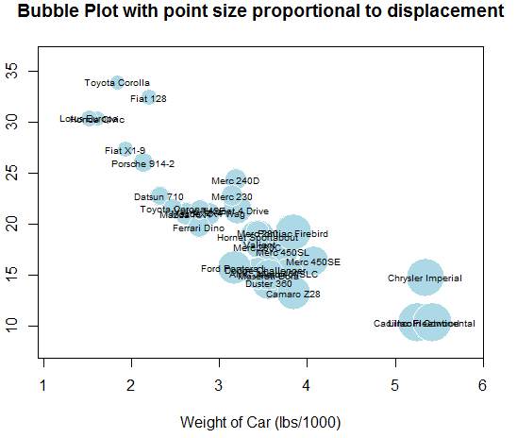
Bubble Plots
CSCI 6907-13 Big Data & Analytics
CSCI 6907-13 Big Data & Analytics

Slide 67
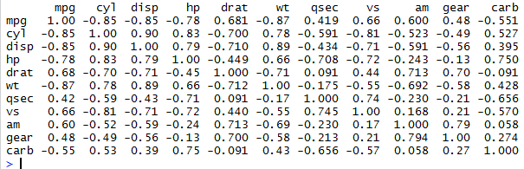
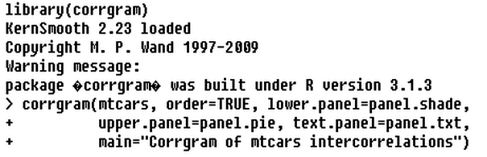
Correlations
Correlation matrices are a fundamental aspect of multivariate statistics.
  Describes which variables are strongly related to each other
    options(digits=2)
    cor(mtcars)
  Which variables are most related? Which are relatively independent?
CSCI 6907-13 Big Data & Analytics
CSCI 6907-13 Big Data & Analytics

Slide 68
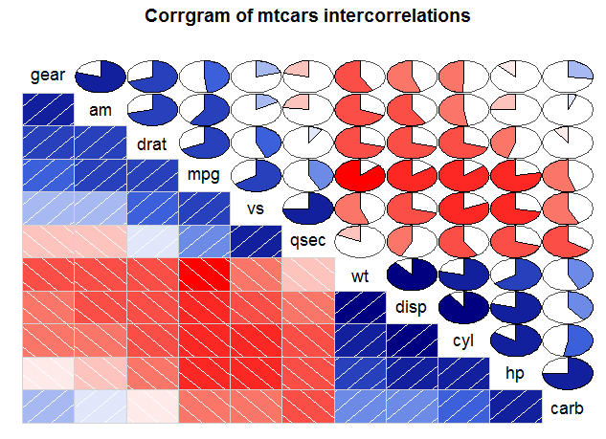
Correlograms
Start w/ lower triangle of cells.
Blue color and hashing from lower left to upper right represents positive correlation.
Conversely, red color and upper left to lower right hashing is a negative correlation.
Darker and more saturated the color, the greater the magnitude.
CSCI 6907-13 Big Data & Analytics
CSCI 6907-13 Big Data & Analytics

Slide 69
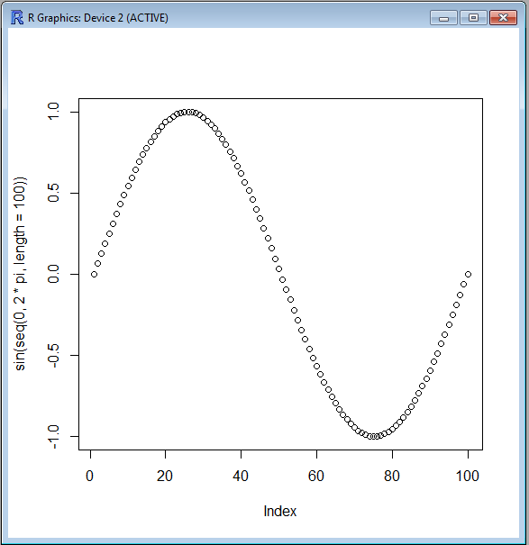
R Plotting Function
plot(sin(seq(0, 2*pi, length=100)))
CSCI 6907-13 Big Data and Analytics
2-<number>
2-<number>

Slide 70
Another Example of R Plotting
x <- stats::rnorm(50)
opar <- par(bg = "white")
plot(x, ann = FALSE, type = "n")
abline(h = 0, col = gray(.90))
lines(x, col = "green4", lty = "dotted")
points(x, bg = "limegreen", pch = 21)
title(main = "Simple Use of Color In a Plot", +
xlab = "Just a Whisper of a Label", +
col.main = "blue", col.lab = gray(.8), +
cex.main = 1.2, +
cex.lab = 1.0, font.main = 4, font.lab = 3)
2-<number>

Slide 71
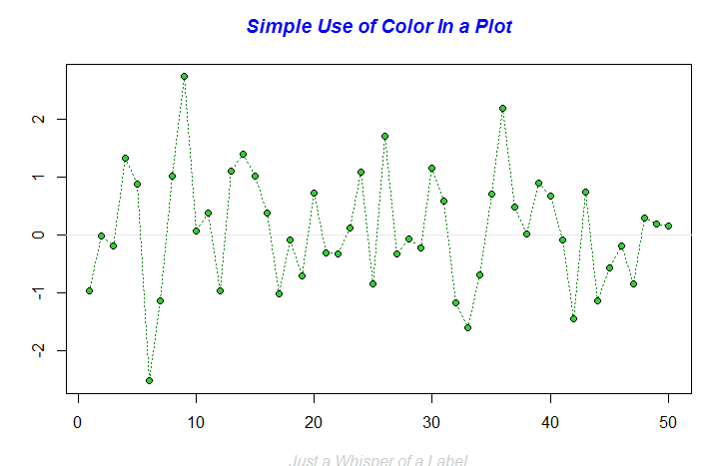
And, the plot …
2-<number>

